Slide 1

Data Driven Education
Natural Language Processing (NLP) Subteam
Presentation 1 - 2/5/2020

Slide 2
Team Members
Yuntian Zhang
Project Manager
Data Scientist
Xinran Yu
Data Scientist
Morgan Powers
Project Manager
Web Developer
Lindsey Blackmore
Web Developer
Erin Wrobel
Researcher
Notes:
All

Slide 3
Overview of Last Semester
Focused on the Piazza data for ISYE 6501
Goals of the subteam
  Data Science Team
  Web Application Team
Accomplishments
  Analyses and visualizations that Xinran and Jianan did
  Initial web mockup
Reflections
  Better communication and integration among the subteams
  More understanding of all the resources available
Notes:
Lindsey, Xinran

Slide 4
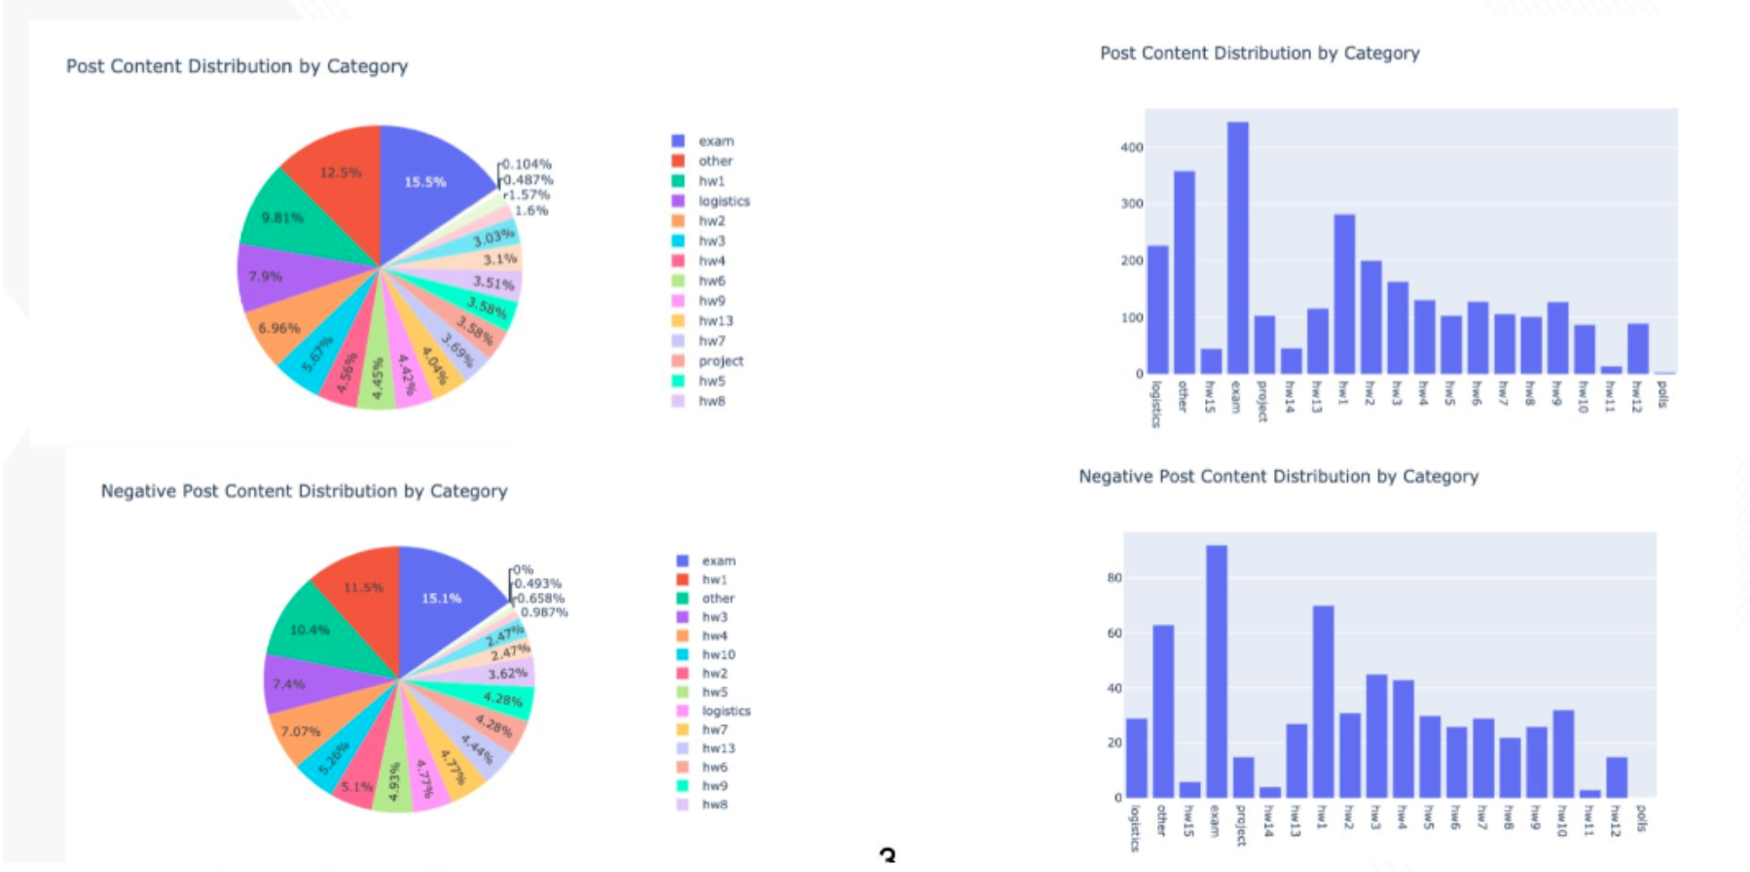
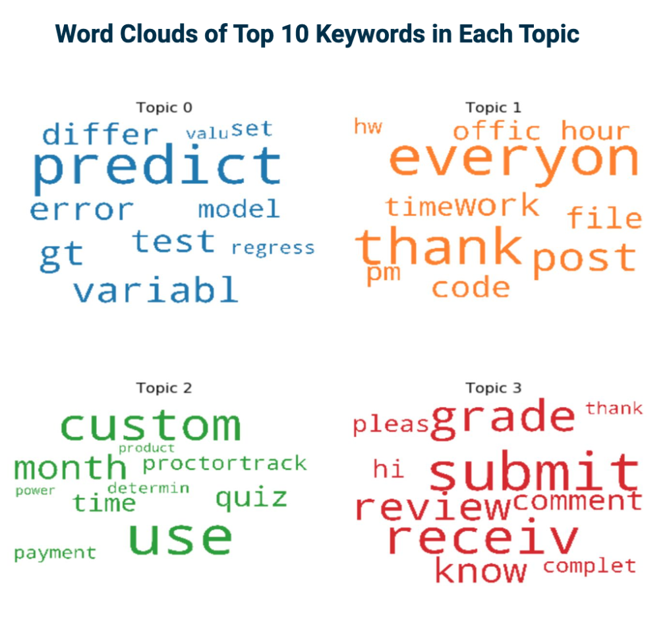
Recap of Data Analysis (Fall 2019)
Performed basic sentiment and statistical analysis on Piazza data
Generated visualizations using Plotly
Stored the results in Jupyter Notebook

Slide 5
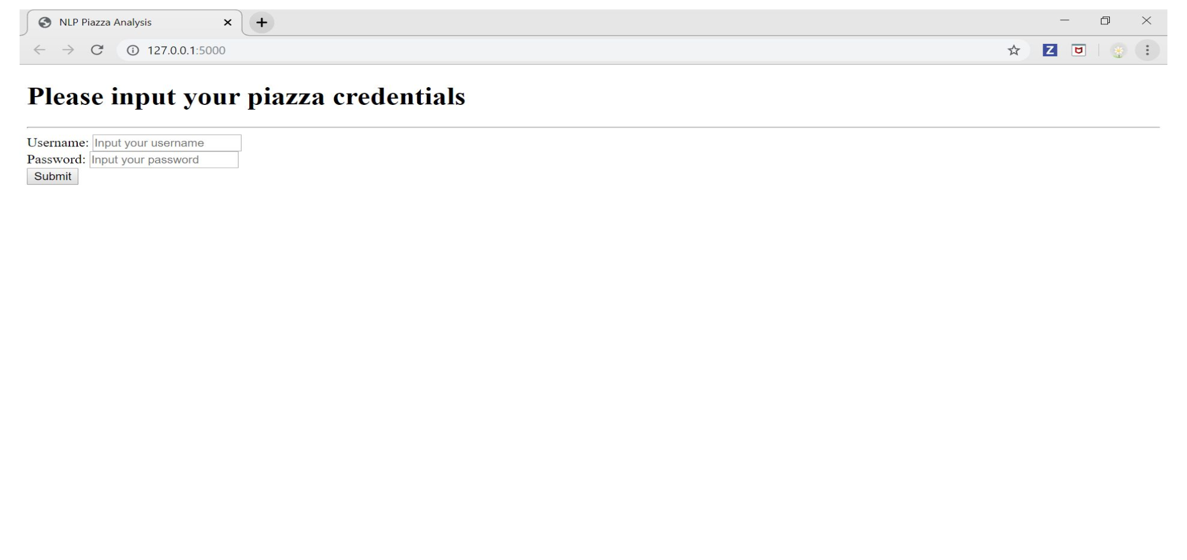
Recap of Web Application Development (Fall 2019)
Mockup for the flow and aesthetics of the web app
Front-end for the credentials page

Slide 6
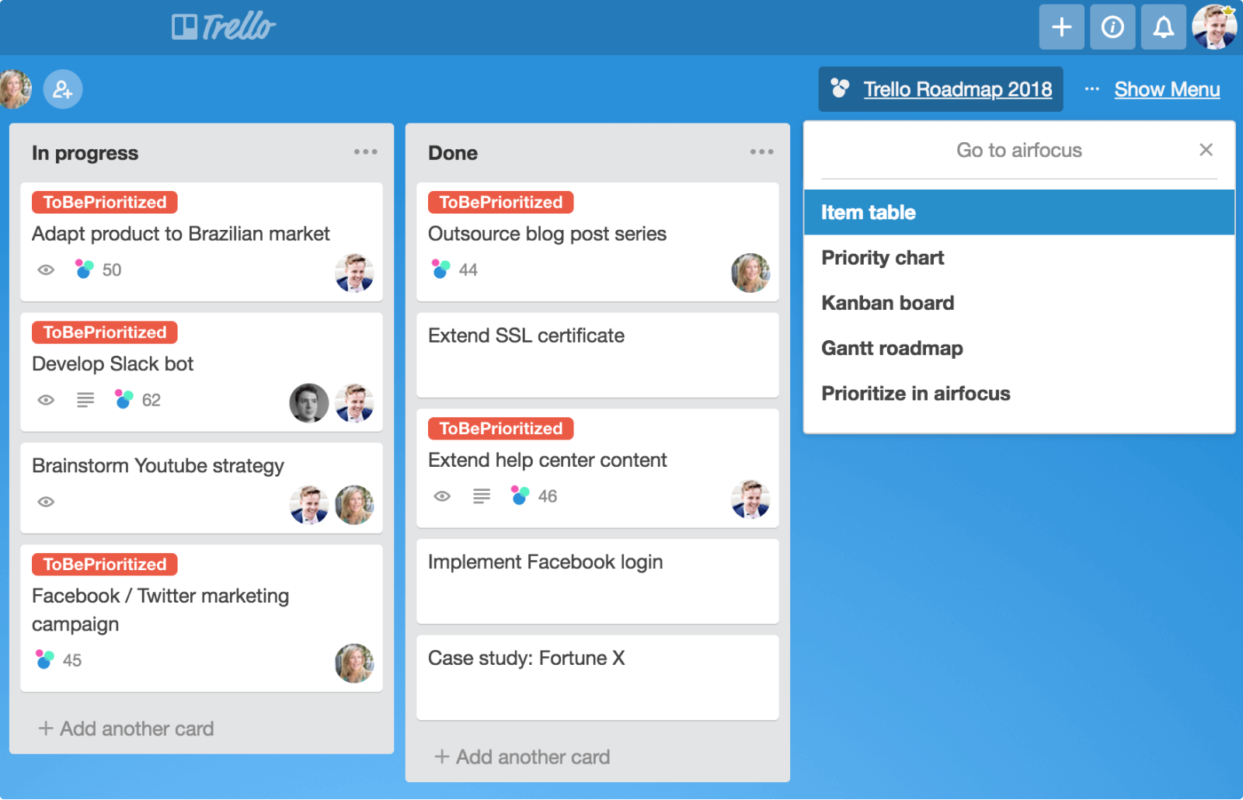

Takeaways
Better communication and integration among the subteams
More understanding of all the resources available
Utilize Scrum boards (Trello) and Slack

Slide 7
From Piazza to Canvas
Piazza
Data from ISYE 6501 classes
Topic & Sentimental Analysis
Visualizations over different categories
Canvas
Data from sandbox Canvas course
Design a web-application that can be used in Canvas
Display statistics & visualizations on a specific class/student/instructor

Slide 8


Reasons for this Change
Possible FERPA violations with the use of Piazza for GT courses
Canvas API simplifies the collection of discussion forum data
Lack of utilization of the Discussion feature within Canvas

Slide 9
Goals on Data Science
More Visualization and statistics on different views
  Class level
  Student level
  Instructor level
Deeper understanding of a specific student’s behavior and performance
Cognitive Presence Assessment
More Functionalities based on Canvas API
  Possibility of combining discussion data with other data available on Canvas

Slide 10
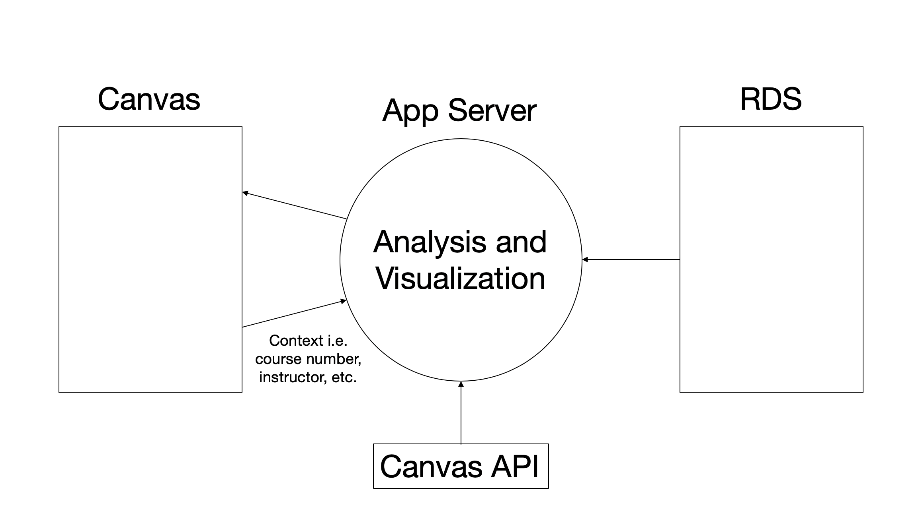
New and Improved Web Application
Flask app that will run the Python scripts on the data pulled from Canvas
  This will work for basic sentiment analysis but a database will most likely need to be established to do things like topic analysis
No need for a credential login page

Slide 11
Plans for Research
Goal: Ensure what we’re doing is useful!
Educational research
  What data best reflects success in a course?
  How can discussion forums most effectively be utilized?
    how do we encourage it?
  How much predictive power does NLP analysis of discussion boards have?
Market research
  What do professors want to see?
  How can we make Canvas/the web app most appealing?
  What sorts of changes would encourage student engagement?

Slide 12
Future Directions for Research
Evaluation of the web app’s launch
  Professor response
  Student response
  Statistical differences?
Student-view app
  Data to suggest future study habits
  Is there a need/would it encourage participation?

Slide 13
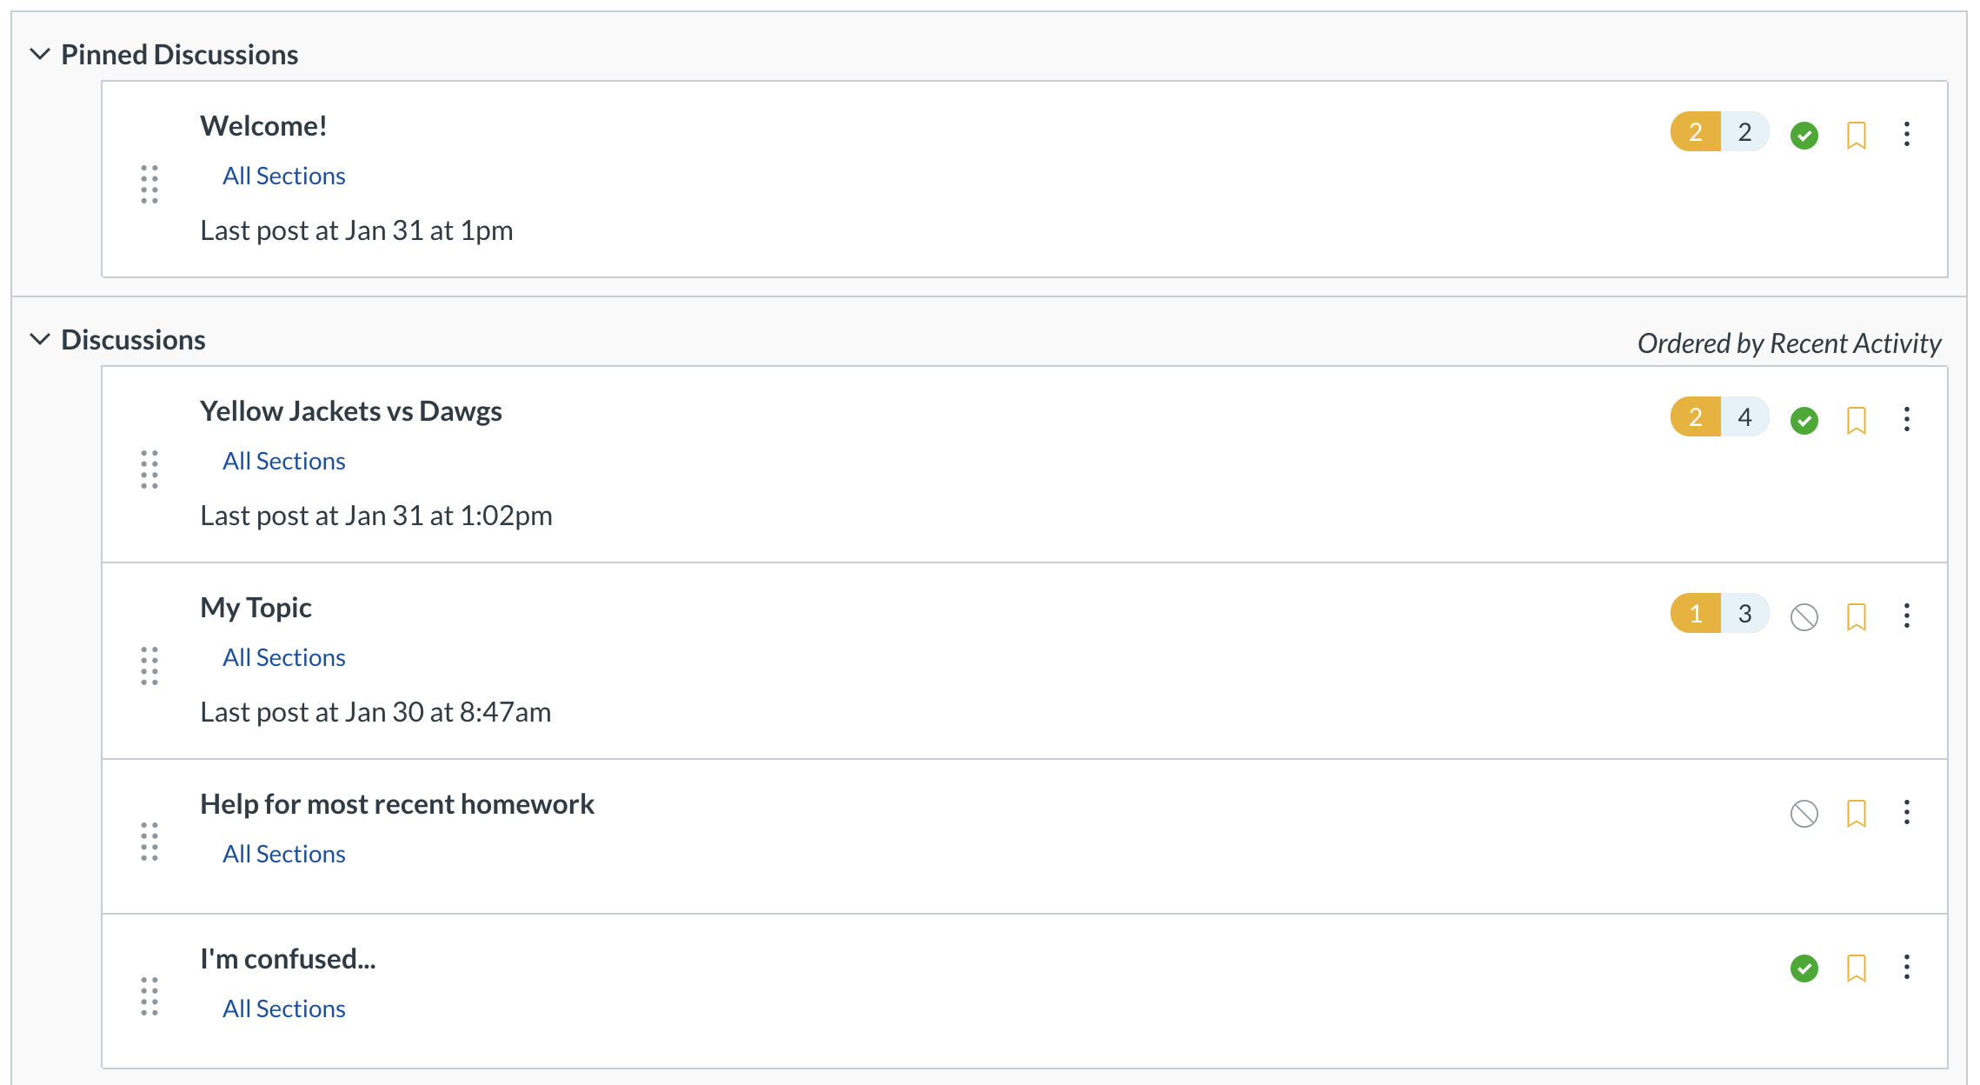

Goals for the Coming Month
Create a few mockups in Adobe XD and then present them to stakeholders during the interviews for their input
Generate more data on the discussion board
Get access to the discussion board data using the Canvas API
Perform initial statistical analysis on the Canvas data
Integrate Python scripts into the Flask app

Slide 14
Questions?

